Slide 1

Investigating CTEV (Clubfoot) Orthosis through Re-design, Automation and Alternative Mechanism
FYP’2023
DURATION – 01TH AUG, 2022 TO 13TH MAY, 2023
Submitted By: Group-P2
Ananya Maheshwari-2019UME1218
Mohit Khemchandani-2019UME1246
Shailesh Suthar-2019UME1168
Supervisor: Dr. Harlal Singh Mali
Associate Professor Department of Mechanical Engineering
MNIT, Jaipur

Slide 2
CONTENTS
Introduction to CTEV
Prior Efforts in CTEV Clubfoot Orthosis
Assembly Video: Worm and Worm Gear Mechanism
Introduction
Objective
Technical issues identification in existing clubfoot orthosis
Technical issues rectification in existing clubfoot orthosis
Prototype development of Forefoot of Orthosis
Prototype development of Hindfoot of Orthosis
Automation in Existing Clubfoot Orthosis
Automation in existing clubfoot orthosis
Hardware and software requirement
Root development of clubfoot
2DOF linkage mechanism
3DOF linkage mechanism
6DOF linkage mechanism of Orthosis
Alternate locking mechanism
Alternate locking mechanism
Mechanism selection
Working mechanism
Prototype development
Conclusion and Future Scope
Thank-you

Slide 3

Background understanding

Slide 4
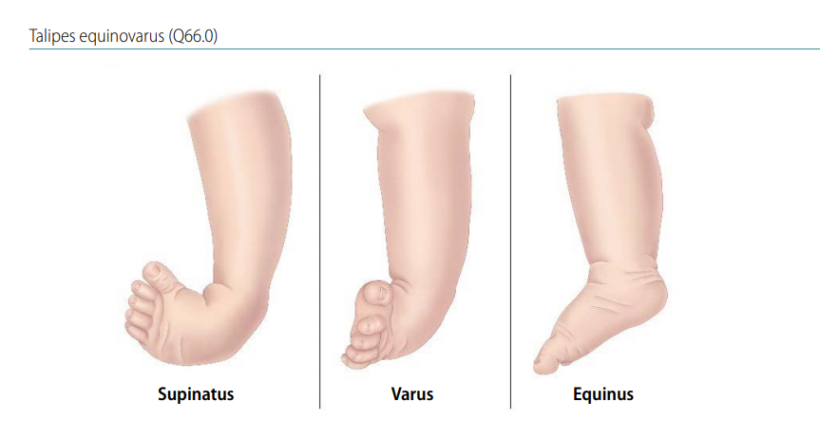
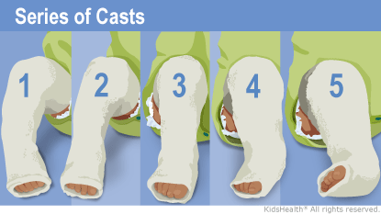
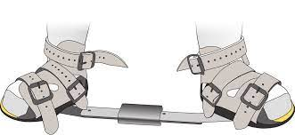
INTRODUCTION TO CTEV
Congenital Talipes Equinovarus also known as Clubfoot, is a complex, congenital deformity in which the foot is twisted out of shape.
Our objective is to develop a corrective orthosis for this disease which can be worn by the new-born child.
The major requirements of this orthosis are that it should be of low cost and weight so that anyone can afford it and can be worn by the child comfortably
Earlier for rectifying this kind of deformity into the new born baby we were using Ponseti Method.
Fig.1 Deformities in Clubfoot
Fig.2 Ponseti Method

Slide 5
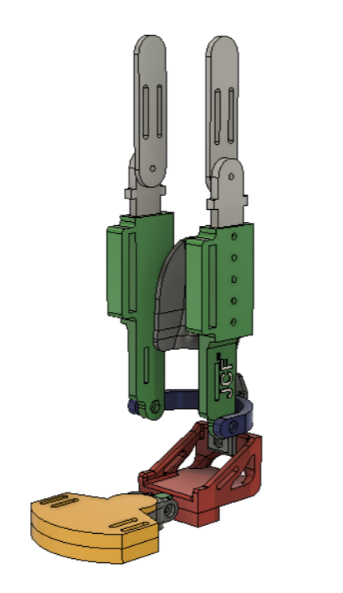
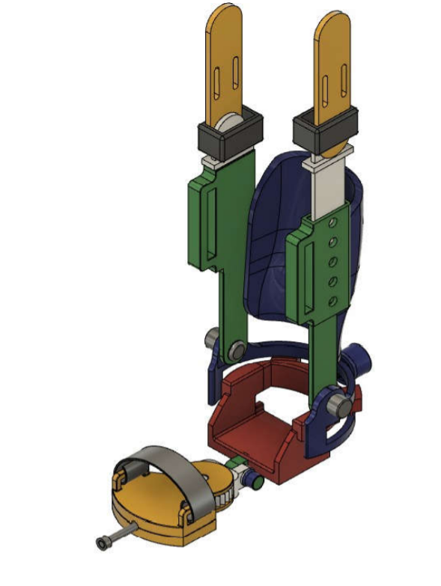
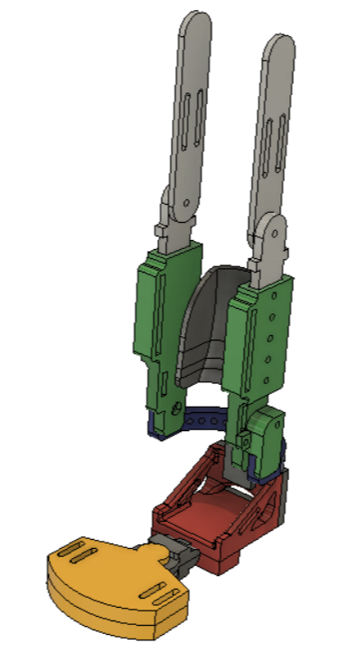
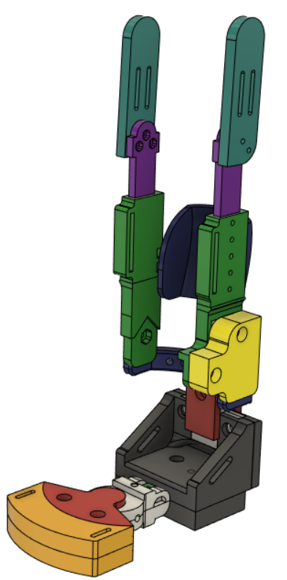
PRIOR EFFORTs
2018
2019
2020
2021
Fig. 1‑9 (a) Interference Indexing Mechanism (b) Nut and Bolt indexing mechanism (c) Friction locking mechanism Worm-Gear (d) Friction locking mechanism with metallic seating for worm gear placement.

Slide 6
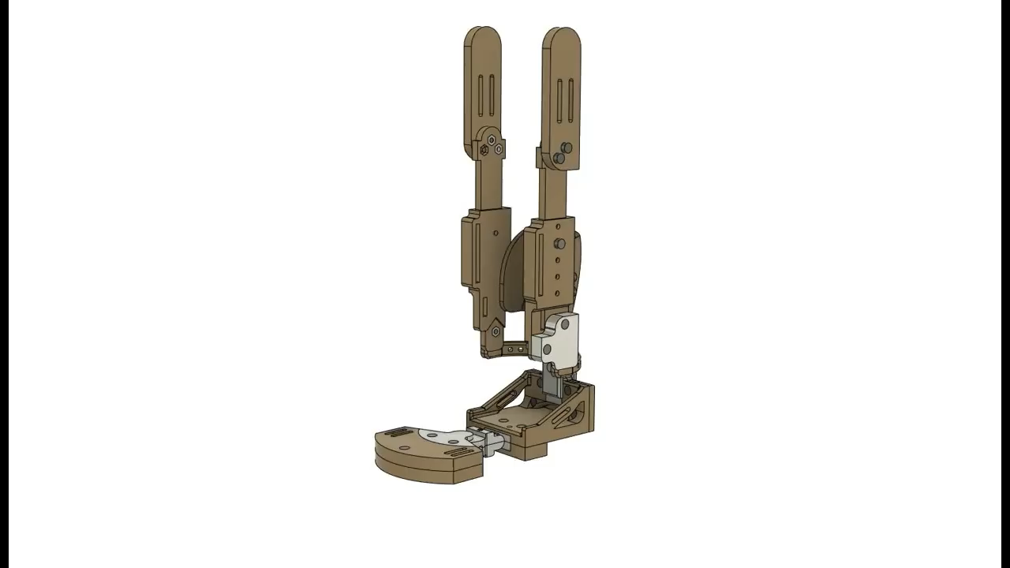
ASSEMBLY VIDEO: WORM & WORM GEAR MECHANISM

Slide 7
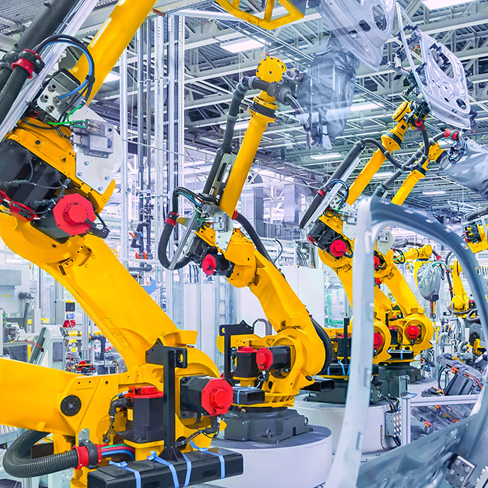


TECHNICAL ISSUES IDENTIFICATION IN CLUBFOOT ORTHOSIS
Manufacturing
Actuation
Cost & time
Too small parts
Low precision
Shrinkage was high during investment casting
Very costly and time consuming
7

Slide 8

OBJECTIVE
Re-design the clubfoot orthosis to rectify the criticality into an actuation which actuated using worm and worm gear mechanism.
Investigating the scope of automation in clubfoot using MATLAB.
Re-design the clubfoot orthosis to incorporating alternate locking mechanism of motion.

Slide 9
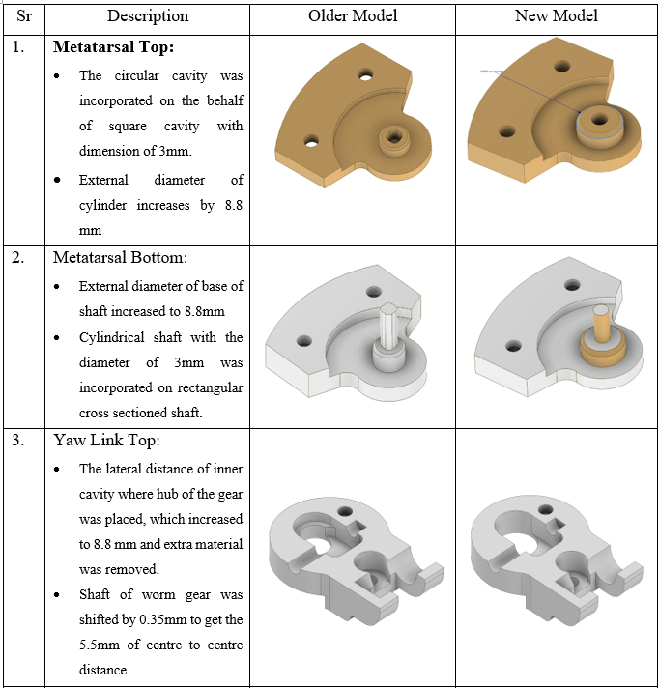
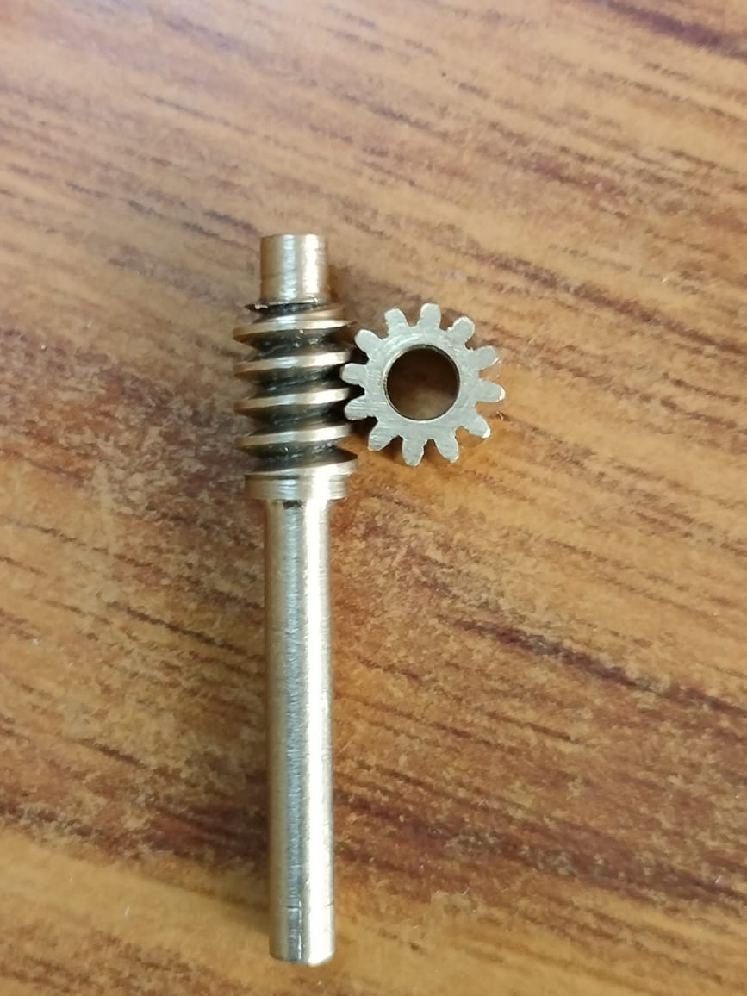
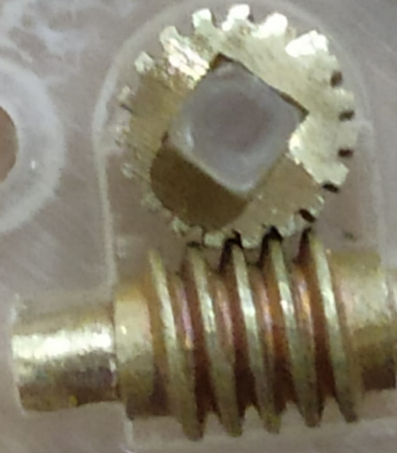
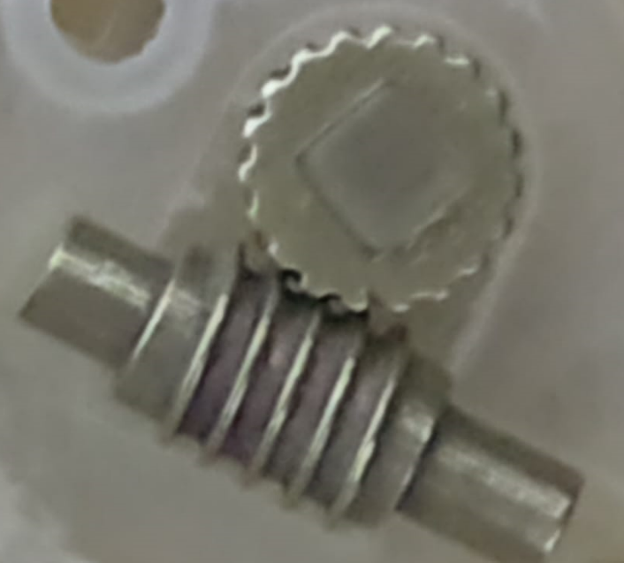
TECHNICAL ISSUES RECTIFICATION IN EXISTING CLUBFOOT ORTHOSIS
Swadeshi Gear manufacturer
Customised worm and worm gear
Standard worm and worm gear
Made by investment casting
Made by CNC
Accepted
Rejected

Slide 10
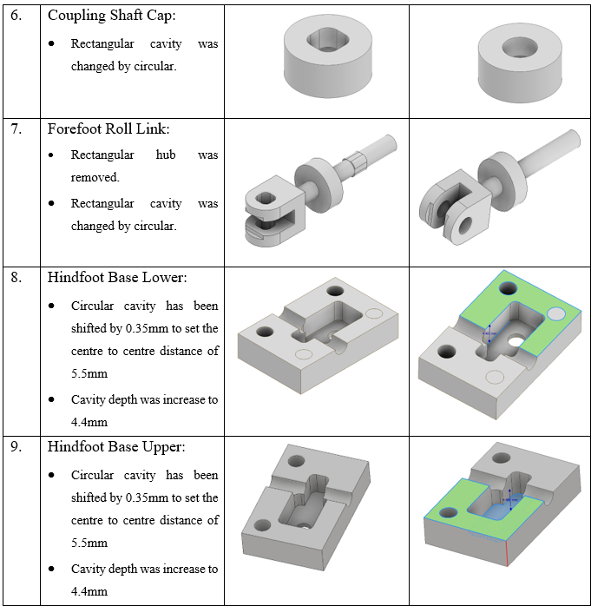
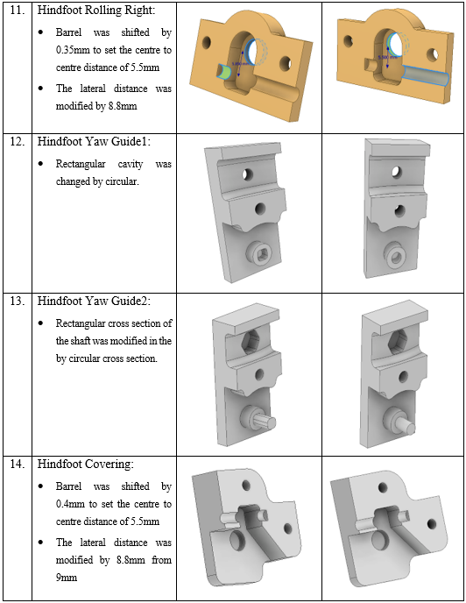
TECHNICAL ISSUES RECTIFICATION IN EXISTING CLUBFOOT ORTHOSIS

Slide 11
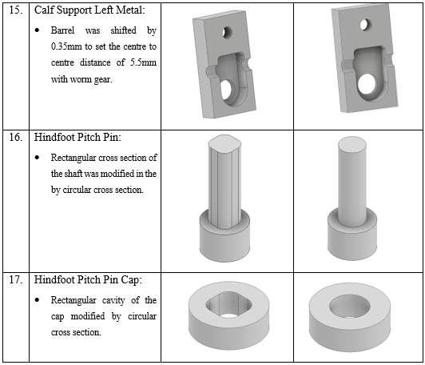
TECHNICAL ISSUES RECTIFICATION IN EXISTING CLUBFOOT ORTHOSIS

Slide 12
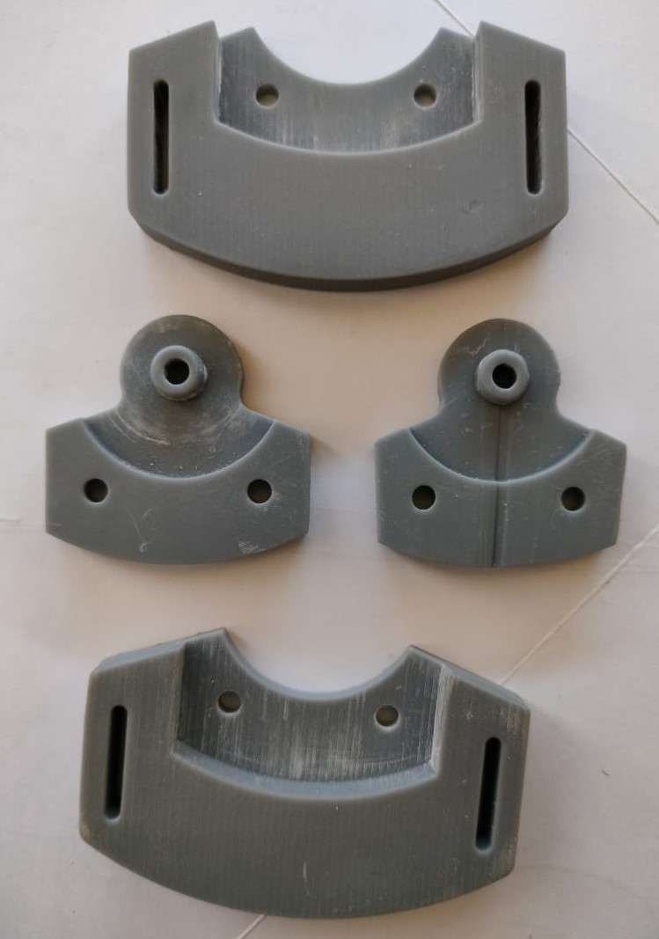
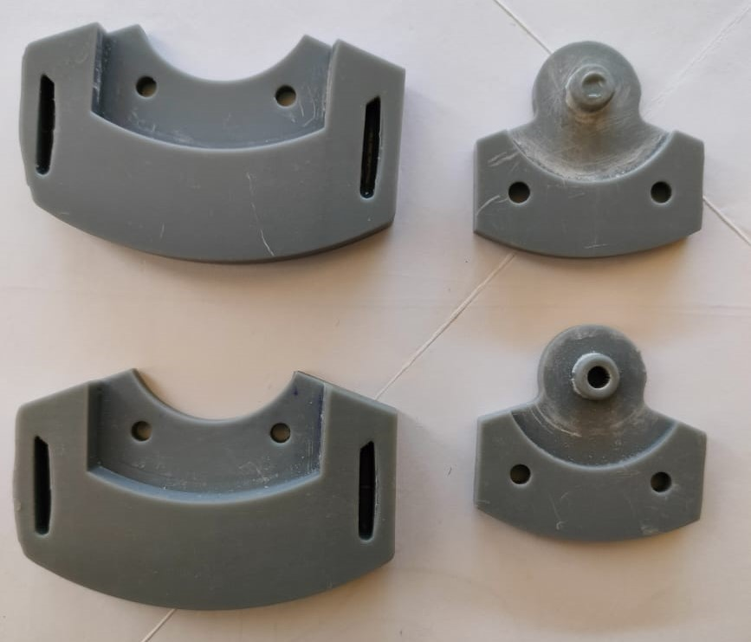
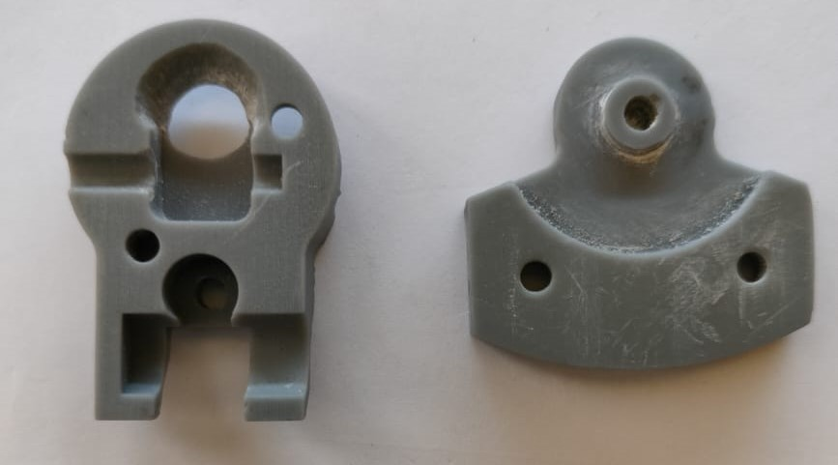
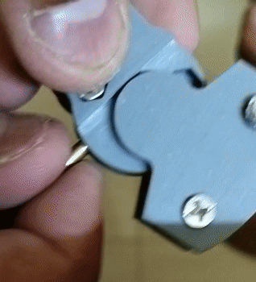
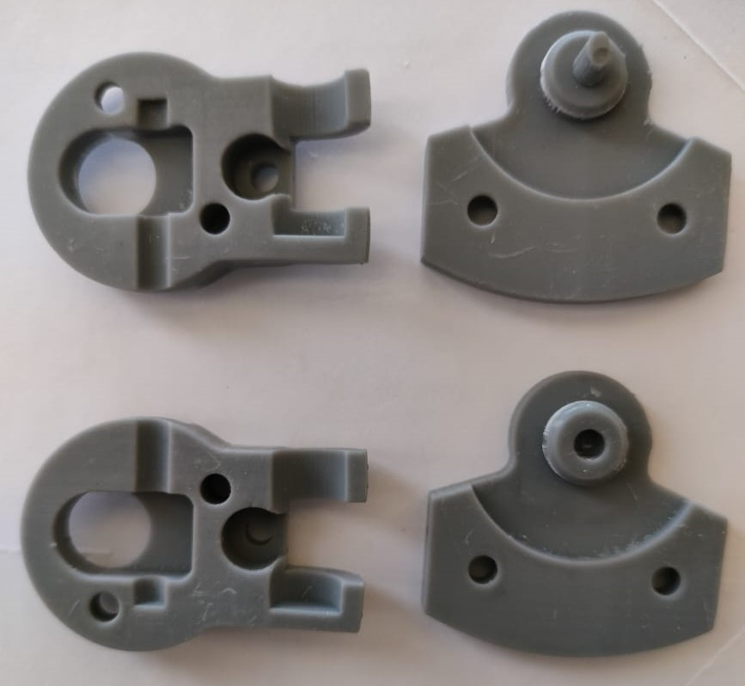
PROTOTYPE DEVELOPMENT OF FOREFOOT OF ORTHOSIS
Iteration-1
Iteration-2
Iteration-3
CAD Model with exact dimension
CAD Model with Shrinkage allowances
Addition of Filling allowances
Iteration-4
Final Design
encountering filling allowances with shrinkage allowances

Slide 13
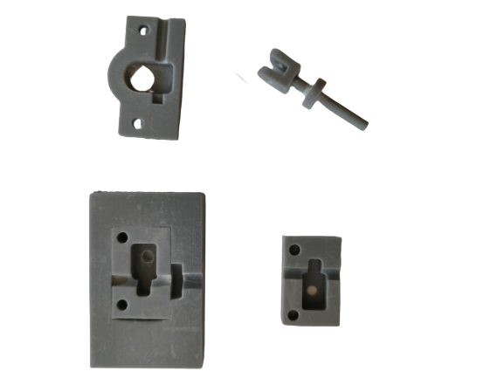
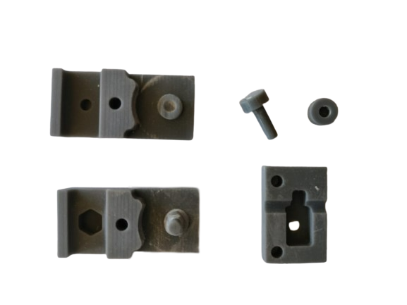
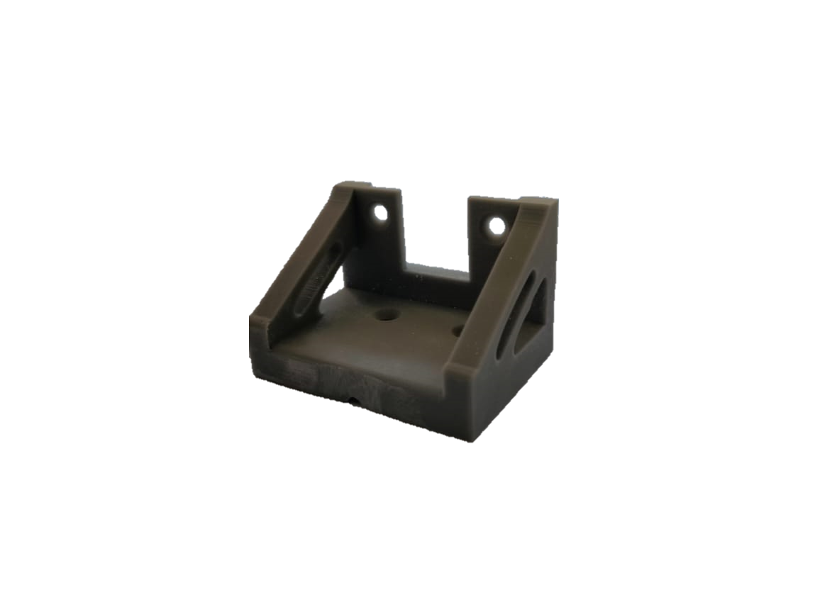
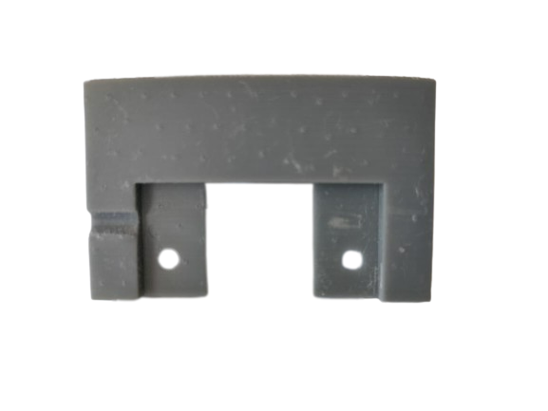
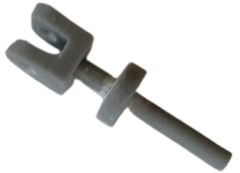
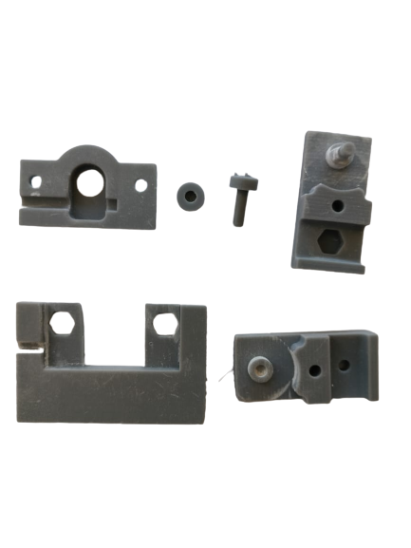
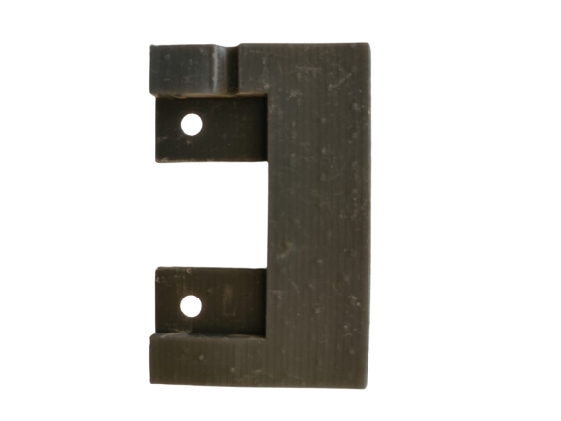
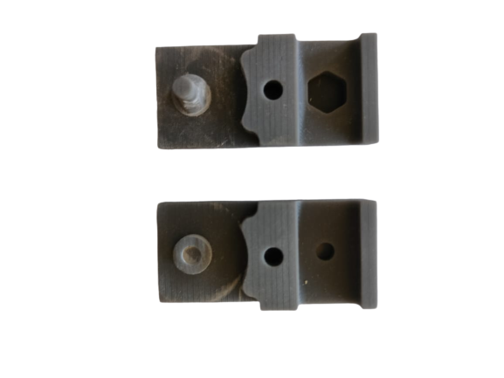
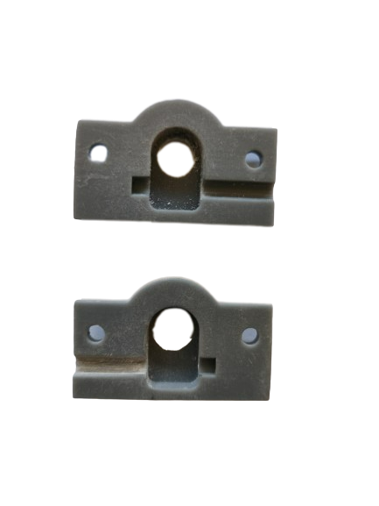
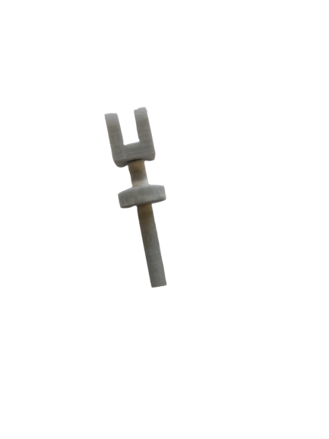
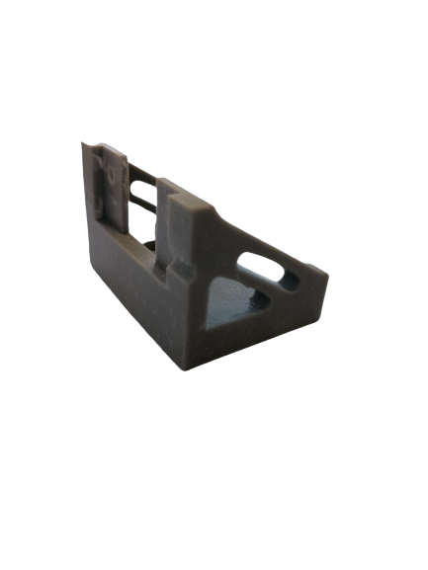
PROTOTYPE DEVELOPMENT OF HINDFOOT OF ORTHOSIS
Iteration-1
CAD Model with exact dimension
Iteration-2
Encountering filling allowances with shrinkage allowances

Slide 14

AUTOMATION IN EXISTING CLUBFOOT ORTHOSIS

Slide 15
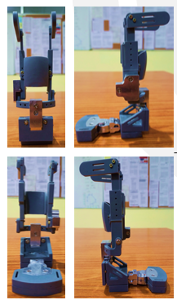
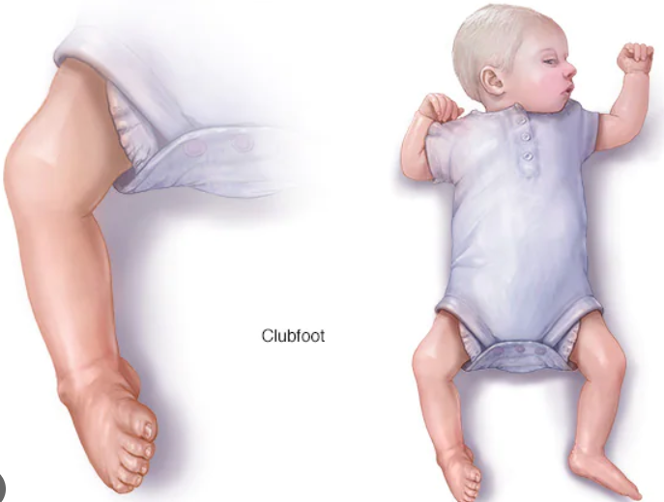
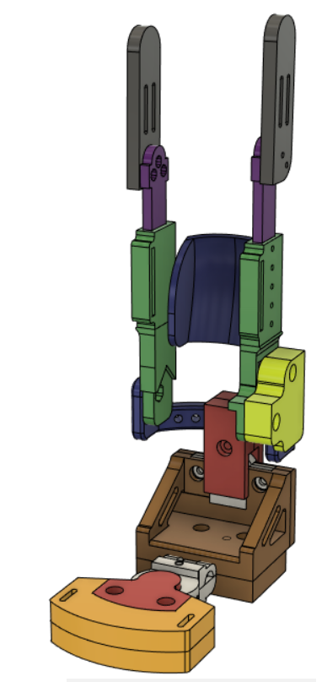

AUTOMATION IN EXISTING CLUBFOOT ORTHOSIS
Children having Clubfoot problem
Wearing mechanical type orthosis
Go to the doctor for weekly check-up and monitoring the orthosis
AUTOMATION
Next level
Excessively laborious
Time-consuming

Slide 16
HARDWARE AND SOFTWARE REQUIREMENT
Software:
MATLAB & Simulink
Inventor & OnShape: for building the assembly of clubfoot and integrate with MATLAB
Hardware:
Stepper motors: getting installed on each pivot point of clubfoot
Arduino
Jumper wires
Battery
Breadboard

Slide 17
ROOT DEVELOPMENT OF EXISTING CLUBFFOT ORTHOSIS
In which we will integrating stepper motor at each pivot point which were previously actuated using a worm and worm gear mechanism.
An automated orthosis would be able to make an accurate prediction of the trajectory along which the deformed foot would eventually revert to its original shape.
To do this, we used MATLAB to plot out the predictable path or a trajectory that orthosis should follow.
2 DOF Mechanism
3 DOF Mechanism
6 DOF Mechanism
Orthosis

Slide 18
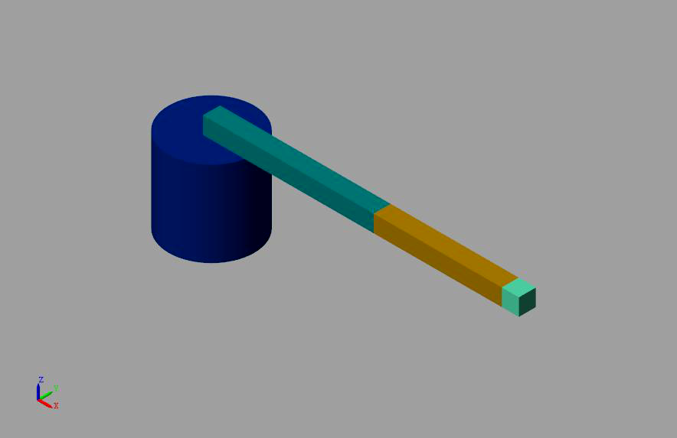
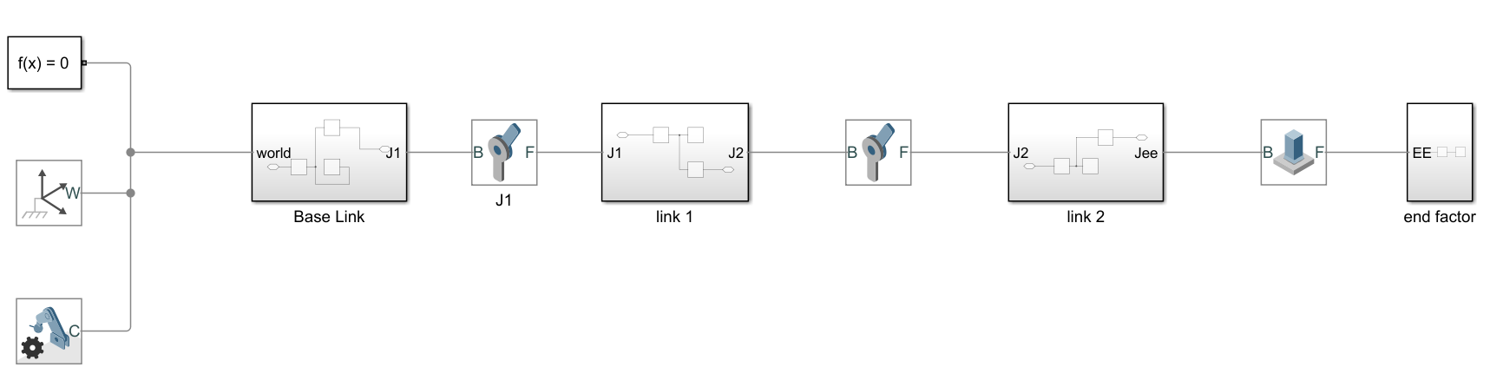
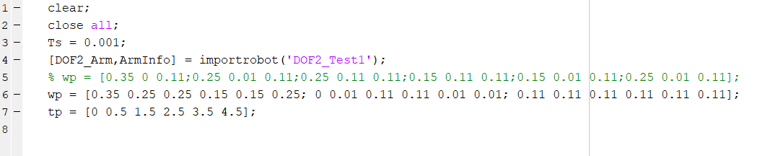
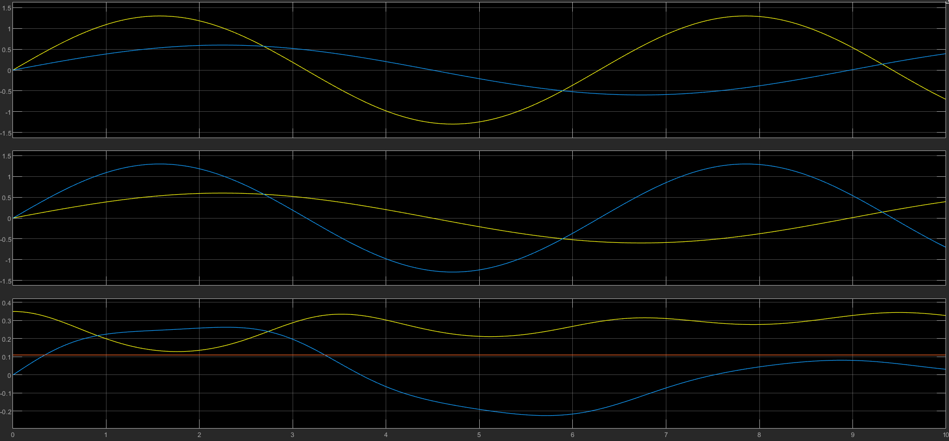
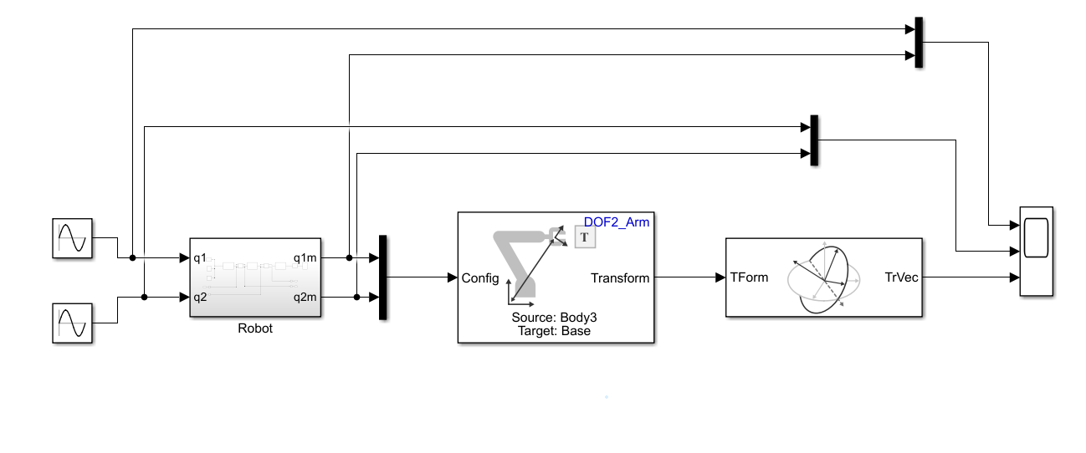
LINKAGE MECHANISM: 2DOF
Assembly Creation
Forward Kinematics

Slide 19
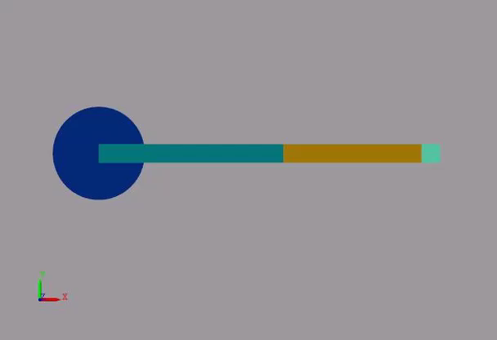
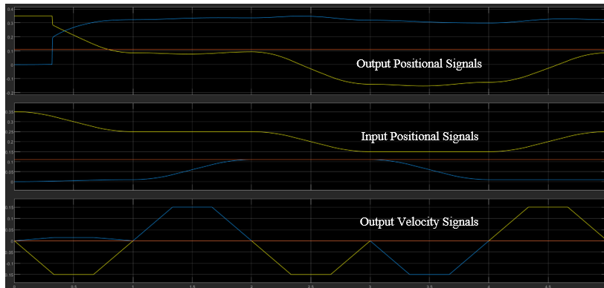
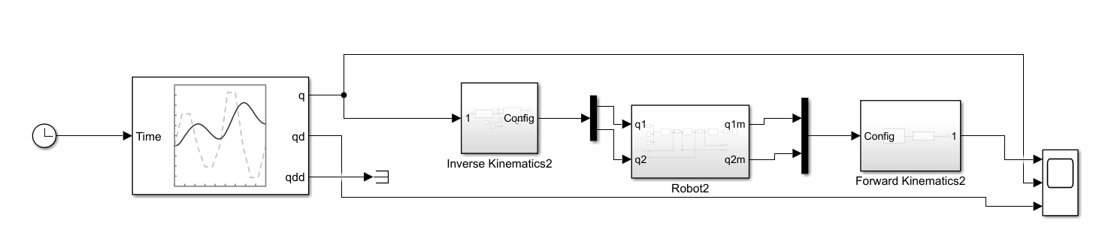
LINKAGE MECHANISM: 2DOF
Inverse Kinematics

Slide 20
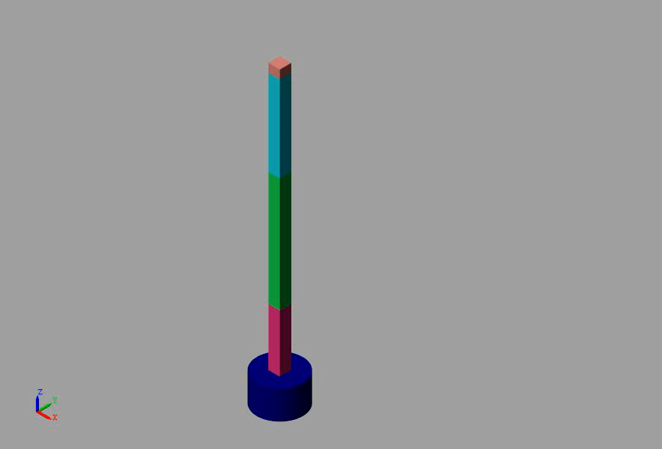
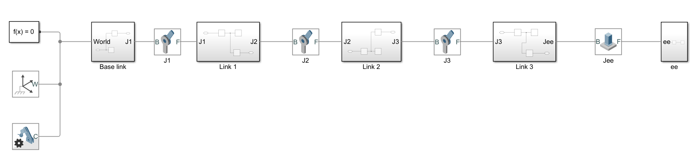
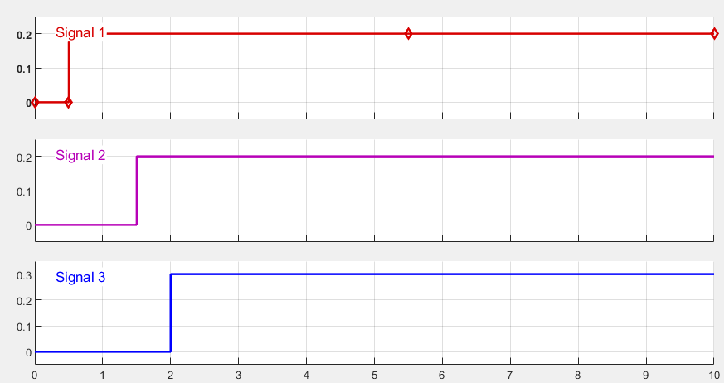
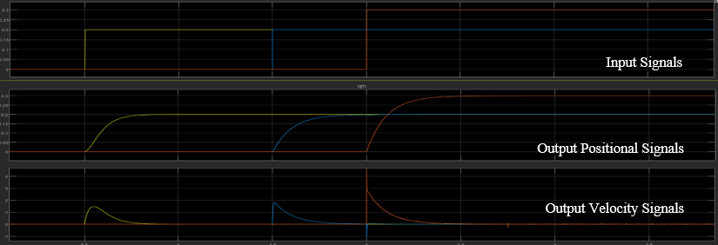
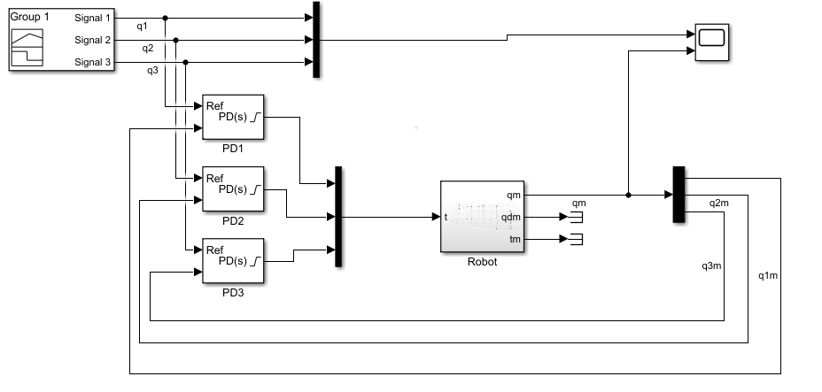
LINKAGE MECHANISM: 3DOF
Assembly Creation
Forward Kinematics

Slide 21
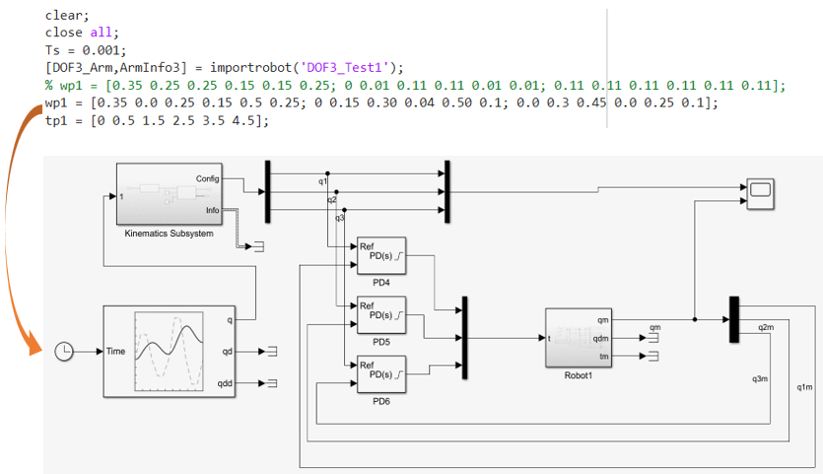
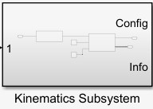

LINKAGE MECHANISM: 3DOF
Inverse Kinematics

Slide 22



LINKAGE MECHANISM OF ORTHOSIS: 6DOF
Assembly Creation

Slide 23




LINKAGE MECHANISM OF ORTHOSIS: 6DOF
Forward Kinematics
Input Signals
PD Controller Tuning

Slide 24

LINKAGE MECHANISM OF ORTHOSIS: 6DOF
Forward Kinematics

Slide 25

LINKAGE MECHANISM OF ORTHOSIS: 6DOF
Inverse Kinematics

Slide 26

ALTERNATE LOCKING MECHANISM

Slide 27
ALTERNATE LOCKING MECHANISM
The manufacturing of worm and gear is a very expensive process
mainly due to its very small size and specialized manufacturing techniques and setups involved.
Quality control process also add to this cost.
This would make the orthosis unaffordable and out of reach for certain group of people.
Thus, a need arises to look for different mechanism to lock the degrees of freedom of the orthosis.
The aim is to look for mechanism which can be assembled easily while using standard off-the-shelf products or those which can be easily manufactured, without heavy setup.
27

Slide 28



MECHANISM SELECTION
Mechanism |  | Pros | Cons
2 Pin Mechanism |  | Uses very simple components which are easily manufacturable. | Low resolution Cannot withstand high forces as contact area is small.
3 Gear Mechanism |  | Has a very high resolution Reliable and can withstand high forces. | Complicated assembly. Position of gears cannot be calculated.
Fastening Mechanism |  | Very simple assembly No specialized parts required. Has infinite resolution | Poor reliability Position may gradually change due to jerks and impacts Cannot withstand high forces.
28

Slide 29

THREE GEAR DESIGN AND CALCULATIONS
Pitch diameter (D) | 6.6666 mm
Diametral pitch (P) | 3.0002
Circular pitch (CP) | 1.047 mm
Module (m) | 0.3333 mm
Addendum (a) | 0.1667 mm
Dedendum (b) | 0.4166 mm
Working Depth (h) | 0.7499 mm
Tooth Thickness (t) | 0.5235 mm
Fig. 4‑4 Spur Gear with 3mm Hole
29

Slide 30



WORKING MECHANISM
Since manufacturing of worm and worm gear along with automation is too costly.
Thus to make the orthosis cheaper, we need to look at some other less costly mechanism to lock the rotation.
30

Slide 31

ASSEMBLY VIDEO
31

Slide 32



PROTOTYPE DEVELOPMENT
First, a fixture was designed to test out if the proposed mechanism will work or not.
The fixture is 3D printed along with the gears.
Positive outcome of the fixture promoted us to design the complete orthosis assembly with the new ‘3 Gear’ mechanism.
Since off-the-shelf
Fig. Prototype for Yawing motion
Fig. Fixture for stability of 3 gear mechanism (i) CAD design (ii) SLA Printed Fixture

Slide 33


CONCLUSION

Slide 34
CONCLUSION AND FUTURE SCOPE
The primary objective of this final year project was to improve functionality of the existing orthosis and investigating the scope of implementing automation.
Parallel to investigation of automation and development of the orthosis with alternate mechanisms was also done.
The alternate mechanisms explored were such that their manufacturing, quality assurance, testing and assembly were much cheaper compared to the existing worm and gear assembly.
Although efforts have been made to improve the orthosis by including automation and looking for alternate mechanisms, it is still not ready to be used, and has much room for improvement.
The future work may include developing the orthosis prototype incorporating the hardware for orthosis automation, which includes procurement of items such as stepper motors, sensors, IDE, battery packs, etc, after which design changes may be done to incorporate these sensors and motors in the orthosis.
Further, integration of work on MATLAB Simulink with the hardware is necessary.
34

Slide 35
CONTRIBUTION
Existing Orthosis Re-Design
Automation in Clubfoot
Mohit Khemchandani
2019UME1246
Shailesh Suthar
2019UME1168
Alternate Locking Mechanism
Ananya Maheshwari
2019UME1218

Slide 36


